Slide 1
This PowerPoint Sample Slide deck contains examples used in multiple ZIM events held in the 2020-21 membership year.
Thank you to the following PTAs that supplied the samples:
Casselberry PTA, Florida
Colorado PTA
European PTA
Everett High PTA, Washington
Florida PTA
Michigan PTA
Pennsylvania PTA
Penn Kidder PTA, Pennsylvania
Twin City Elementary PTA, Washington
Washington State Region 7 PTA
For more details about building a slide deck, read the Design, Build and Present a Zooming into Membership Slide Deck FAQ included in the Zooming into Membership Kit.

Slide 2


HOUSEKEEPING
AUDIO
CHAT BOX
Click on the mic icon to mute and
unmute yourself. Make sure you are muted.
Feel free to use the chat box to ask questions and share.
CAMERA
RECORDING
Click on the camera icon to turn on/off. Keep it on, so we can see you.
For your information, this event is being recorded. We'll send you a link to it along with a PDF and a survey.
CHECK-IN
ENJOY
Use the chat box to tell us your name and
your PTA/PTSA.
Sit back and enjoy the event! (And invite your PTA board and friends to join future gatherings!)
Notes:
Sample Housekeeping Slide from Pennsylvania PTA

Slide 3


January 28, 2021
Notes:
Sample Theme Slide/Section Marker Slide from Pennsylvania PTA
If your event is centered on a theme, consider using a theme slide at this point. This is optional.

Slide 4


Zooming Into Membership
Notes:
Sample Theme Slide/ Section Slide from Colorado PTA
This slide was created using a word cloud online tool. Search “free word cloud” on your browser to find tools to create one.

Slide 5

Notes:
Sample Agenda Slide from Washington State Region 7 PTA.

Slide 6


AGENDA
Introduction: Region 7, Washington State PTA
Membership Tips/Resources: National PTA Membership Outreach Team
Questions & Answers
Celebrating our Units’ Successes: Everett High PTA 7.3.85
Membership Tips/Resources: Region 7 Platinum Winner Advice & “Communication is Key”
Our PTAs/PTSAs Matter: WSPTA Director “Membership, Advocacy, and FACE”
Closing Comments, Prizes, and Thanks!
Notes:
Sample Host PTA and Presenters (combined) Slide from Washington State Region 7 PTA, Washington State PTA, and Everett High PTA.

Slide 7



Add PTA Name
Notes:
Sample Additional Presenter Slide

Slide 8

Why do we PTA?
Our Shared Mission:
To make every child’s potential a reality by engaging and empowering families and communities to advocate for all children
Notes:
Sample Mission Slide – National PTA strongly recommends you include a Mission slide.

Slide 9
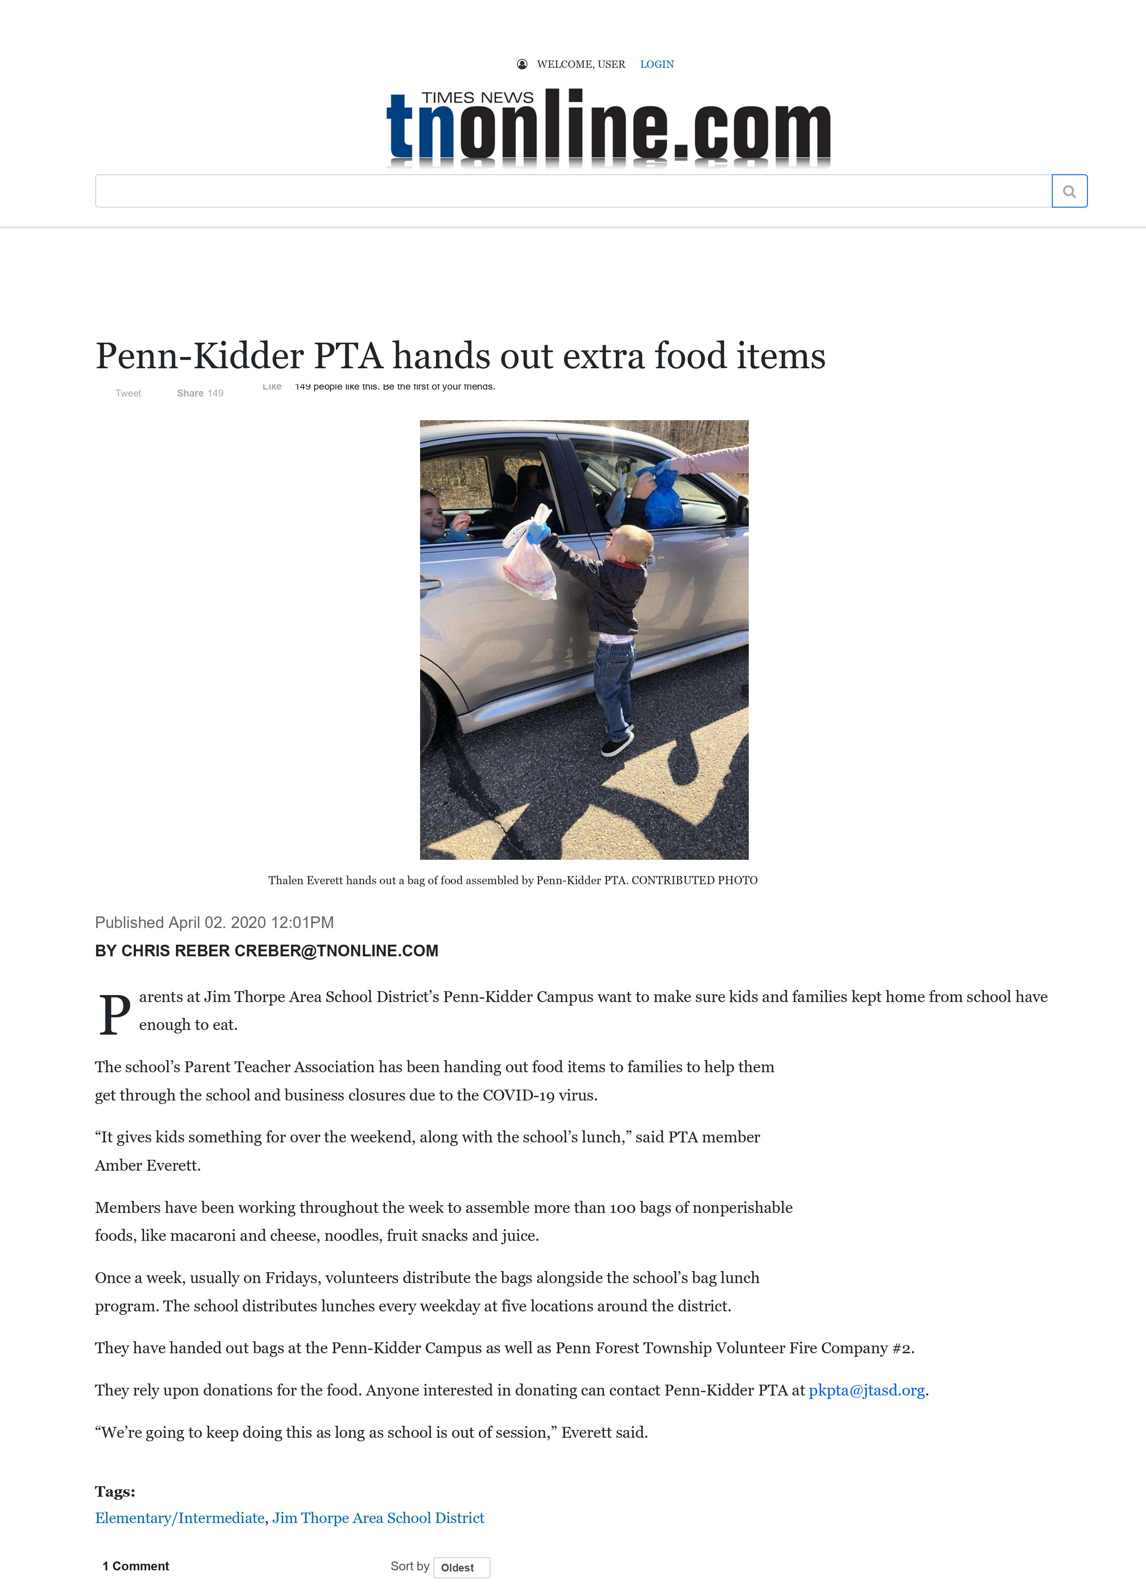




Celebrating our Units Successes: Penn Kidder PTA
Notes:
Sample Local Unit Slide from Penn Kidder PTA and Pennsylvania PTA

Slide 10
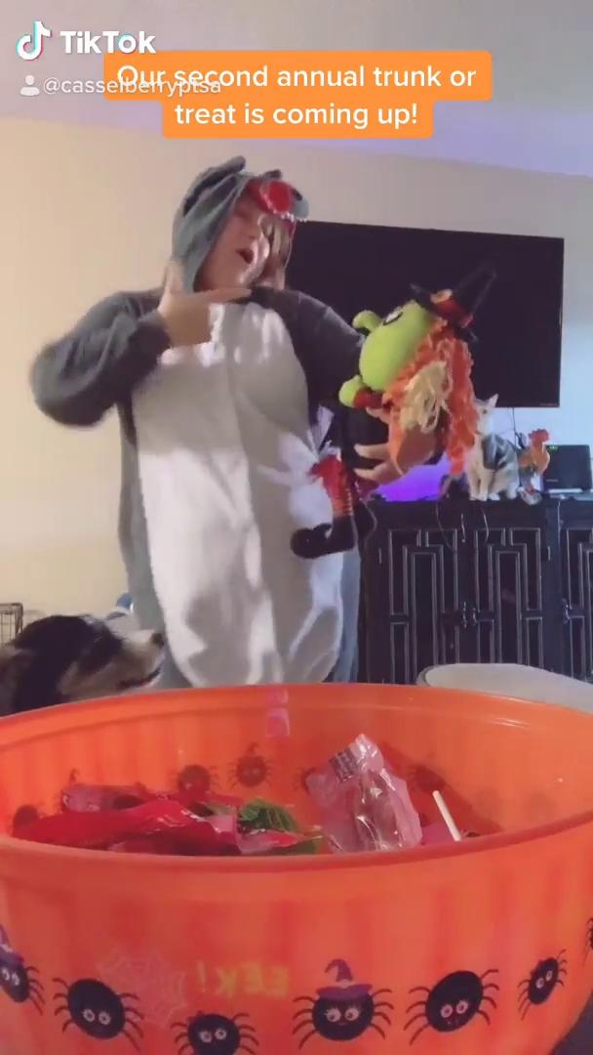
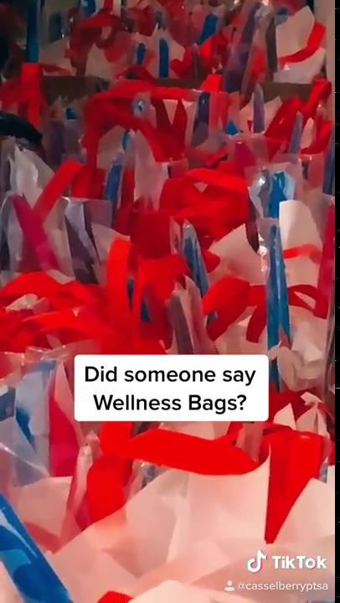

Have fun with a purpose!
Notes:
Sample Local Unit slide from Casselberry PTA and Florida PTA
This slide contains three embedded Tik Toks. This unit uses Tik Tok to engage members, promote PTA’s work, and grow membership.
You can embed a video—either online or one stored on your device--using the “Insert” tab in Power Point. For instructions on how to do this, visit Microsoft at https://support.microsoft.com/en-us/office/insert-a-video-from-youtube-or-another-site-8340ec69-4cee-4fe1-ab96-4849154bc6db#:~:text=In%20PowerPoint%2C%20go%20to%20the,Code%2C%20and%20then%20press%20Enter.
If you plan to share a video:
Embed the video and test the video during rehearsal.
Have the video ready-to-go on another device just in case technology fails and the slide deck does not work properly.
Be sure you know how to share the video sound when sharing your screen on your platform. For Zoom events, you must check “share computer sound” when you share your screen.

Slide 11
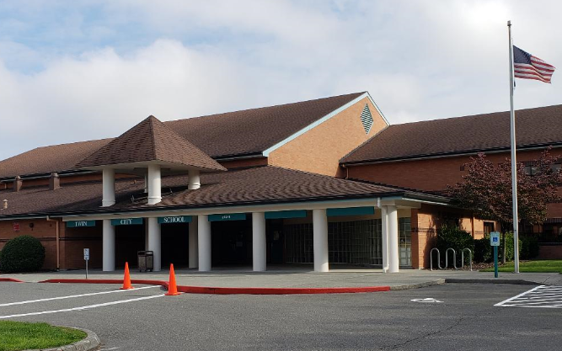

Celebrating Our Unit Successes: Twin City Elementary PTA Stanwood-Camano School District
Paid PTA
Memberships,
by Year
Title I School
Rural community
Approx. 400 students
Moderate PTA participation
2015-16 = 69
2016-17 = 73
2017-18 = 75
2018-19 = 89
2019-20 = 116
30 percent increase in memberships
In 1 year!
Notes:
Sample Local Unit Slide from Twin City Elementary PTA and Washington State Region 7 PTA.

Slide 12

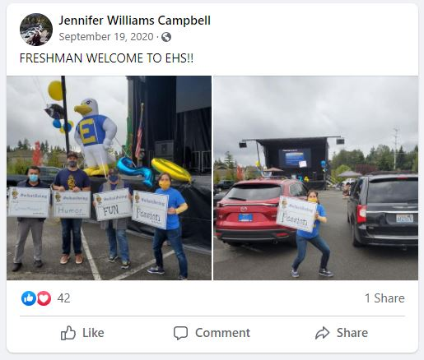
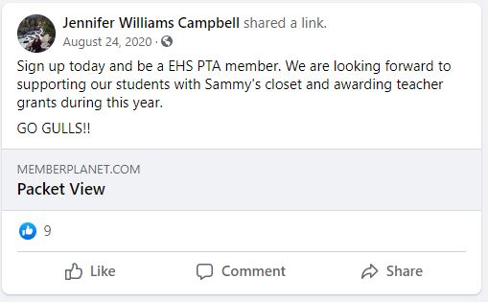

Social Media Posts
Notes:
Sample Local PTA Slide from Everett High PTA and Washington State Region 7 PTA.

Slide 13


We want to hear from you…
Notes:
We strongly suggest using a poll or other activity after the local unit presentation that asks attendees to process what they just heard and apply it to their own situation.
You may want to ask: Did you hear an idea that you will use in your community? (if polling, Yes, Already doing some of it. No.) Or ask, who will you tell about the presentation you just heard? Or ask, what is one thing you just heard that you could try in your community?
The Zoom platform allows you to include polls. They can be added before and during the Zoom event. See your Zoom settings for more information and be sure to rehearse using the poll as well so you are familiar the tools. PowerPoint will also allow you to add an extension to online polling programs. If you plan to stop the presentation to show a poll located outside of the slide, be sure to have the poll up and ready before you start the presentation. Polls are good for yes/no and multiple-choice questions.
You can also encourage engagement by asking questions and encouraging attendees to write their answers in the chat box. The facilitator should read a few examples and acknowledge the ideas being shared in the chat box. The chat box can be used for open-ended questions, sharing of ideas, etc

Slide 14

Be positive. Fill your social media and communications (both PTA accounts and personal accounts) with optimism, gratitude, and humor. Negativity breeds negativity. The more supportive, positive thoughts we can generate, the better our community will manage and grow together.
Communication. Provide accurate information. Have links on your PTA website or in your communications to PTA resources, school and district resources, education suggestions, food banks, etc. Be the go-to place for families at a time when they are feeling overwhelmed.
Collaborate with school efforts. PTAs can work with the school or school district to provide support. Is there a food bank supporting the children in your community where you can direct donations? An online food drive?
Notes:
Sample Host PTA Slide from Pennsylvania PTA

Slide 15

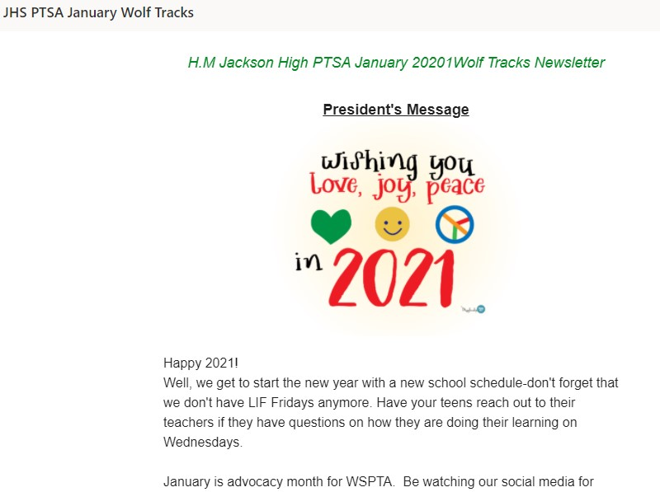
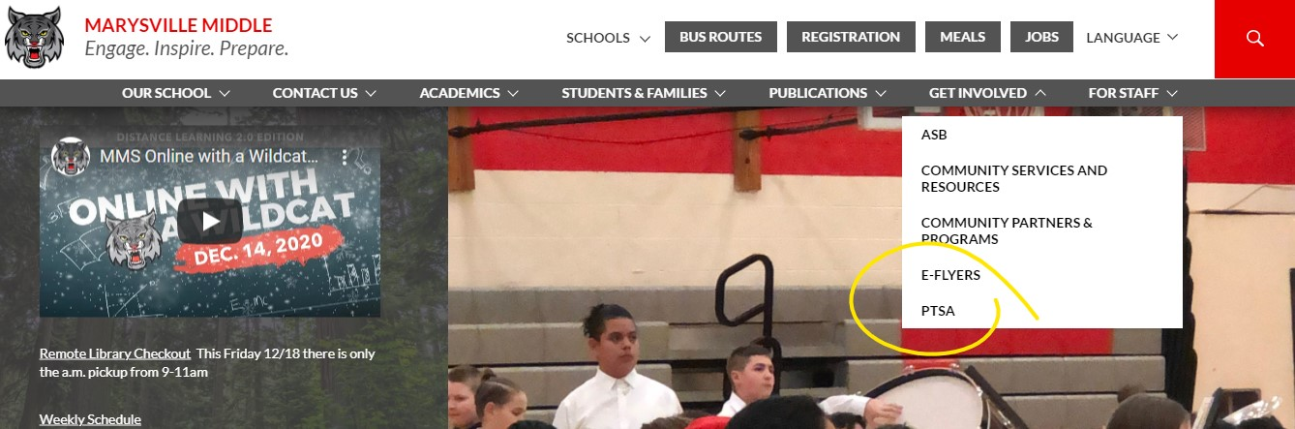

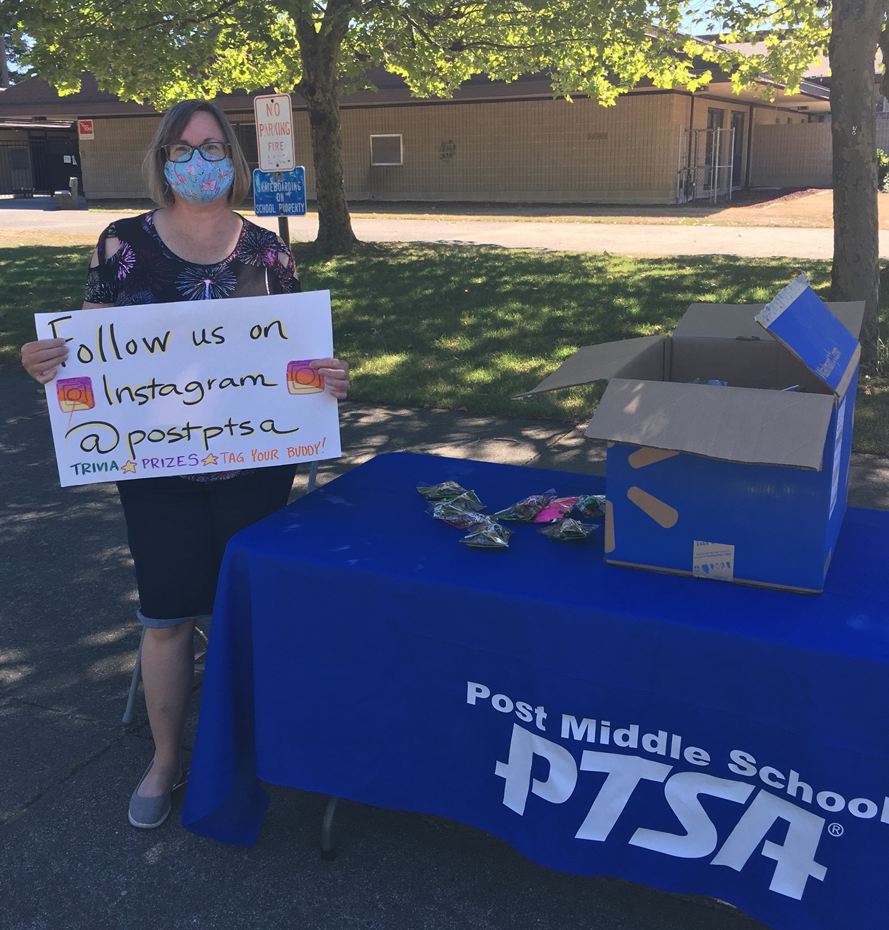
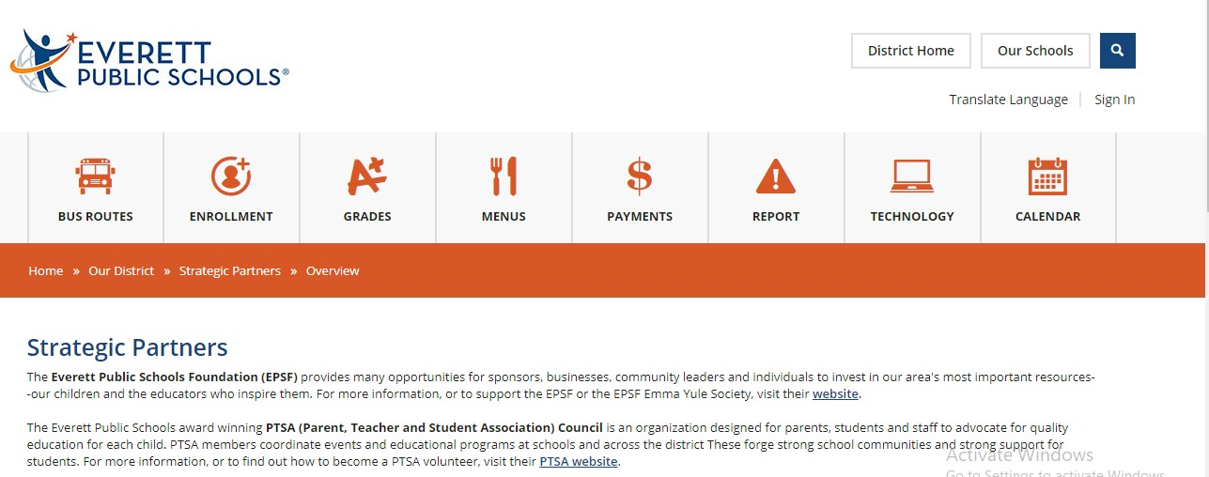

Communication is KEY
Membership: Region 7
Methods of Communication:
School Newsletters space
School/District website links
Social Media
Email blasts
Paper flyers at materials pick ups
Prize drawings
Digital flyers like Peach Jar
Merch! Stickers, magnets, note pads, spirit wear, etc.
Notes:
Sample Host PTA slide example from Washington State Region 7 PTA.

Slide 16


CONGRATULATIONS TO KAISERSLAUTERN MS PTSA!!!
Notes:
Sample Host PTA Slide announcing the winner of a membership challenge from European PTA.

Slide 17

Virtual PTA activities. Don’t stop connecting with your community, just think outside the box. Ideas that PTAs are doing across the state:
holding an online art contest;
showcasing a virtual spirit week;
organizing an online read-a-thon;
continuing weekly math challenges but do it through the website or Facebook page;
reaching out to school staff to post fun, short bios about staff members.
Notes:
Sample Host PTA Slide from Pennsylvania PTA.

Slide 18
Tips from the National PTA Membership Outreach Team!
Notes:
Sample Section Introduction Slide

Slide 19
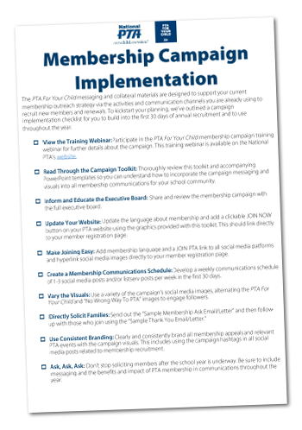


Membership Campaign: pta.org/membershipcampaign
Notes:
Sample National PTA Slide
Please note that National PTA will provide slides with scripts for your ZIM. Please contact mot@pta.org for more info.

Slide 20

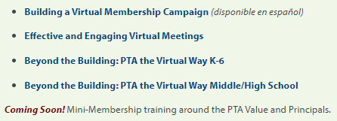
Virtual PTAing
New Mini-Membership Trainings Series:
We would love to hear your feedback on this webinar, please fill out this form.
New trainings coming soon!!
Notes:
Sample National PTA State PTA resources slide
Note: to be sure you have the most updated National PTA resources and slides, please contact mot@pta.org to ask them. National PTA staff will provide slides for your use upon request.

Slide 21

Thank you for joining us!
Notes:
Sample Drawing/Door Prize Slide from Pennsylvania PTA

Slide 22


Know a PTA that is rocking it and should be featured on a future ZIM event?
Let us know!
vp.membership@floridapta.org
Notes:
Sample Host PTA Closing Slide from Florida PTA

Slide 23



Next Zooming into Membership Event:
March 15, 2021 @ 7 p.m.
For PTAing with us today
FOR YOUR CHILD,
and​ FOR ALL CHILDREN!
Notes:
Sample Host State Closing Slide from Michigan PTA

