Slide 1



membership campaign Training
JUNE 2020
Notes:
Presentation Overview:
Section 1 – Welcome & Overview (Slides 2 – 5): 4 minutes
Presenters: LaWanda Toney/Leslie Boggs
Section 2 – Research & Insights (Slides 6 – 15): 12 minutes
Presenter: Jackeline Stewart
Section 3 – Theme & Approach (Slides 16 – 18): 4 minutes
Presenter: Amy Fox
Section 4 – Messaging (Slides 19 – 30): 10 minutes
Presenter Amy Fox
Section 5 – Collateral Materials & Templates (Slides 31 – 35): 5 minutes
LaWanda Toney
Section 6 – Implementation & Closing (Slides 36 – 38): 5 minutes
LaWanda Toney/Leslie Boggs
TOTAL TIME: 40 minutes

Slide 2
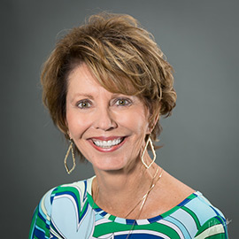

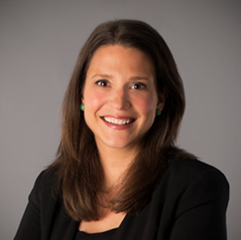

Hello!
Leslie Boggs
President
National PTA
LaWanda Toney
Director
Strategic Communications
National PTA
Amy Fox
Senior Vice President
Edelman
Jackeline Stewart
Vice President
Edelman
Notes:
Time for Section 1 (slides 2 – 5): 4 minutes
Presenter: LaWanda Toney
Script:
Hello and thank you for participating in this webinar to learn about PTA’s new membership campaign
I am LaWanda Toney, I am the director of strategic communications for National PTA and I will be leading today’s training along with:
National PTA President Leslie Boggs
Two of our communications consultants from Edelman
Amy Fox and Jackeline Stewart
Let’s get started!

Slide 3
OUR AGENDA
Welcome & Overview
Research & Insights
Theme & Approach
Messaging
Collateral Materials and Templates
Implementation
Notes:
Presenter: LaWanda Toney
Script:
We have a packed agenda with lots of information to share with you
Our goal for this straining is to provide you with a thorough understanding of PTA’s new membership campaign and enable us to speak with one, consistent voice about the value of PTA
First and foremost, we’re going to review why this campaign is so important and gain a thorough understanding the research and insights used to inform the creation of the campaign
Next, we’ll take a deep look at how we need to talk about PTA and membership
Then, we’ll review the exciting and dynamic visuals that you can use on your website, in emails and on social media
Finally, we’ll review next steps and how you can start implementing the campaign

Slide 4
Why are we here today?
To Make Every
Child’s Potential
a Reality.
Notes:
Presenter: Leslie Boggs
Script:
I really want to thank you for participating in this training session
This new membership campaign is not only exciting, but it is critically important to PTA and its future success
There are many reasons why we’re here and why we’re committed to PTA
At the core, we’re all here is because in one way, shape or form we’re dedicated to PTA’s mission – “To Make Every Child’s Potential a Reality by Engaging and Empowering Families and Communities to Advocate for All Children”
And, we’re committed to our values of collaboration, commitment, diversity, respect and accountability
More than ever, it is critically important that PTA is successfully positioned to support all children today and into the future
Yet, we know that PTA’s critical role is not universally understood or recognized . . .

Slide 5
We’re also here because . . .
“Membership may only be $10, but what is that going to do? ”
“ . . . most people believe the PTA could do a better job recruiting a more diverse base. ​”
​
“PTA doesn’t really look like me.”
“PTA sits quietly in the background.”
“I’m not in any of the little clubs. They are almost like a political group: they want to be like the union for the kids.”
“I wish I could be more involved. I work . . so it’s hard to get home early and make all the events with a full-time job.”
“I have no idea . . . how the funds are helping.”
“At the end of the day, what is the benefit to my son?”
Notes:
Presentation Note:
Quotes will appear automatically
Presenter should speak while they appear on the screen
Presenter: Leslie Boggs
Script:
In fact, there’s a lot of skepticism of and misperceptions about PTA
PTA is often easily dismissed as cliquish and only for stay-at-home moms, or only for families who look a certain way
It is abundantly clear, that many people don’t understand how PTA support’s children, families, teachers, schools and communities
And, these quotes appearing on the screen may or may not surprise you
These were all gathered from the research we conducted to develop this new membership campaign
These perceptions impact not just your individual school, but all of PTA
And, we see it most acutely in the decline in PTA membership across the country
We know that PTA has evolved since its founding more than 120 years ago, but its basic function still remains the same – to support, advocate for and connect parents and teachers to ensure our children reach their full potential
Yet, joining PTA is not always seen as necessary or essential for parents of school-aged children
With a presence in 22,000 schools, by speaking in one voice, we have the opportunity to tell a very compelling and powerful story about who we are, what we stand for and why PTA is so important
So, whether or not these quotes surprise you or it’s exactly what you expected to see, it’s not how we want PTA to be perceived and that’s really why we’re here today
Now, we’ll learn more about the very insightful research findings

Slide 6
Research & insights
Notes:
Time for Section 2 (slides 6 – 15): 12 minutes
Presenter: Jackeline Stewart
Script:
To build a successful campaign, we must start with research
This ensures that our thinking is grounded in fact, not assumption – allowing us to identify the best ways reach your target audiences
For PTA, we conducted primary and secondary research to help us gather internal and external perceptions of PTA
This helped to inform our overall campaign plan and create messaging and visuals that communicate who PTA is in an authentic, compelling and unique way

Slide 7
Research
overview
Focus Group
In-Depth Interviews
Brand Workshop
SEP
OCT NOV
DEC
’19 - ‘20
JAN
JAN
Benchmark Survey
Audience Personas
Notes:
Presenter: Jackeline Stewart
Script:
To ensure our campaign had this strong foundation, we conducted several phases of research so we could gain new insights about the barriers to membership and further explore attitudes and opinions about PTA and its work
First, during PTA’s National Governance Retreat in September we conducted a Focus Group
The goal of the focus group was to explore the challenges and opportunities currently facing PTA
To do this, we conducted a series of interactive exercises among small groups
Next, we fielded a nation-wide, online survey of nearly 1,500 people – both current members and non-members
The objectives of the survey were to:
understand current perceptions of PTA among members and non-members
Determine what is motivating people to join and what are barriers to membership
Gauge how to increase engagement among current and prospective members
Finally, uncover key audience segments and gain insights on what kind of messaging resonates with our target audiences
Building on the survey, we conducted a series of in-depth interviews, also among members and non-members
The objectives of the interviews were to:
Understand the goals parents have for their children that motivate them give and participate in school activities
Identify current perceptions of PTA
Explore barriers non-members face when considering PTA membership
Clarify the value proposition for PTA and factors that might compel prospective members to join
We then took the findings from both the survey and the in-depth interviews and created audience personas of important audience segments
The objectives of the audience personas and segmentation were to:
Gain a deeper understanding of the motivations, challenges and opportunities of these audiences
The final piece was a brand workshop that we conducted with PTA leadership and staff
The objectives of the workshop were to:
Align on key challenges deterring people from joining the PTA that National PTA can solve for
And, jointly develop targeted messaging recommendations that can address these challenges for our key audiences
It was quite a lot of research, but it provided us with deep understanding and insights, that allowed us to develop this campaign
The complete body of research is fascinating and now I will take some time to walk you through our top findings and insights

Slide 8
key Findings
Current Members
BELIEF IN THE VALUE AND BENEFIT OF PTA
MOTIVATED BY FRIENDSHIPS & COMMUNITY IMPROVEMENT
UNCERTAIN ABOUT THE FUTURE OF PTA
PARTICIPATION IS DIFFICULT AND NOT ACCESSIBLE TO ALL
Notes:
Presenter: Jackeline Stewart
Script:
Current PTA members do not need to be convinced that PTA is important, but they want to see the impact the organization has at the local and national level with tangible examples
They also believe in the full breadth of benefits PTA provides, but the core to their motivation to staying involved are the friendships they form and how PTA helps to improve their community
For members, while they’re already bought into to the benefits of PTA, they do want to see the personal relevance to their child
The reasons to be involved are important, but it’s the emotional connection that will maintain involvement
Despite believing in the value of the PTA, members are uncertain about the organization’s future
Whether or not PTA’s best days are ahead is unknown for many
This is rooted in a belief that the PTA is too bureaucratic and it slow to change
To change this opinion, they need to see examples of tangible impact and the organizations future vision
Finally, even current members find PTA participation difficult
This is because they see that their local PTA’s often tap the same individuals and do not represent the entire school community
Current members also believe there are issues with exclusivity and a belief that it’s only for stay-at-home moms

Slide 9
key Findings
Prospective Members
STRONG BRAND AWARENESS
LITTLE UNDERSTANDING OF PTA
ONCE PTA IS DEFINED, PEOPLE ARE INTERESTED
NEED FOR DIVERSITY & INCLUSION
Notes:
Presenter: Jackeline Stewart
Script:
For prospective members, PTA brand awareness is strong but there is very little understanding of PTA
Without a basic knowledge of what PTA does, its impact, its mission, prospects default to preconceived stereotypes
Prospective members also need to see the direct impact on their child
Once prospective members are presented with more information and messaging about PTA, they are more positive and receptive to the idea of membership
Finally, there is a strong desire and need for diversity and inclusion
Multicultural audiences are eager to be engaged in their child’s education and want find additional ways to help their children succeed
Therefore, more inclusive messaging and engagement must happen at the local PTA level

Slide 10
key Findings
Diversity & Inclusion
NECCESARY FOR GROWTH
MESSAGING MUST BE AUTHENTIC AND RELEVANT TO ALL FAMILIES
LOCAL PTAs MUST LEAD BY EXAMPLE
HISPANIC FAMILIES FACE SIGNIFICANT PERCEPTION BARRIERS
Notes:
Presenter: Jackeline Stewart
Script:
Increasing multicultural participation is an opportunity for PTA and absolutely necessary for membership growth
The demographics of our society are changing but what remains the same is that all parents have the strong desire to see their children thrive and succeed
Messaging must ring true to multicultural audiences, as well as families that are not two parent, single income households
Messaging that PTA is accepting of all families and cultures will not be effective if the local PTA experience does not reinforce this
As a result, local PTA behavior impacts the ability to broaden membership
Meeting times, cliquishness and participation limited to a few individuals can drive eager parents to other organizations or activities
Last but not least, Hispanic audiences face significant perception barriers, particularly believing that PTA is not inclusive
They are more likely to believe PTA is biased against low-income and non-English speaking families, as well as undocumented immigrants

Slide 11
audience
segments
PRIORITY: EAGER TO ENGAGE
Secondary: SKEPTICAL POTENTIALS
SECONDARY: Busy multi-taskers
Notes:
Presenter: Jackeline Stewart
Script:
To develop our audience segments our researchers looked at responses about PTA and various personal values and lifestyles, allowing us to identify audiences most likely to join PTA
Our priority segment are Eager to Engagers
Eager to Engagers are composed of highly engaged, diverse, social, younger parents who want to be involved in their children’s education on a deep level
They comprised 38% of our survey sample
One secondary segment are busy multi-taskers
Busy Multi Taskers are motivated by having a relationship with educators and a high level of awareness of school happenings
They are also more likely to be white moms
Our next secondary segment are skeptical potentials
Skeptical Potentials are diverse and engaged in their kid’s education
However, they are dissatisfied with their school’s ability to involve them and are hesitant to engage with other parents

Slide 12

Priority audience:
Eager to engage
View PTA as geared toward stay-at-home parents
Least likely to consider PTA cliquish
Most likely to view PTA as relevant to them
97%
Already familiar with PTA
84%
Believe PTA’s best days are ahead of them
93%
Believe PTA is valuable for schools after receiving messages
Likely to join PTA Before (73%) and After (82%) messaging
Notes:
Presenter: Jackeline Stewart
Script:
More specifically, Eager to Engagers are:
Diverse with more males and multi-cultural parents
Maintaining their cultural heritage is important to them and they have immediate family members born outside of U.S.
More millennials with children in elementary school
They’re sociable and they engage with their kids daily
More motivated to make a difference in their children’s school and advocate for children’s issues
They face many barriers related to a lack of time, but they also have a desire to be involved in other ways

Slide 13

secondary audience:
Busy multi-taskers
Feel engaged in their children’s education
Barrier to participation is lack of time & meeting times
Value access to parent resources, awareness of school happenings, and want to develop relationships with educators
66%
Do not know if PTA’s best days are ahead or behind them
63%
Believe PTA is valuable for schools after receiving messages
59%
Already familiar with PTA
Likely to join PTA Before (15%) and After (37%) messaging
Notes:
Presenter: Jackeline Stewart
Script:
Our Busy Multi Taskers are active and present in their schools, but time constraints and many activities compete for their time
They are mostly likely to be female and white parents living in suburban communities
They work full-time but a large portion are homemakers
Their children tend to begin falling into older grades, moving into Middle and High School
They have a high presence and participation in their school already
Several activities are competing for their time
Their greatest motivators relate to wanting to form a relationship with educators
They are less familiar with PTA and are unsure of its future value
They want to make a difference and are engaged but need direction on how PTA can help

Slide 14

secondary audience:
Skeptical potentials
Says school does not communicate when they try to be involved and they don’t know parents well enough
Consider PTA not relevant to their child’s education
Most likely to agree PTA is cliquish
45%
Believe PTA is valuable for schools after receiving messages
70%
Already familiar with PTA
32%
Believe PTA’s best days are behind them
Likely to join PTA Before (34%) and After (38%) messaging
Notes:
Presenter: Jackeline Stewart
Script:
Skeptical Potentials are most likely to be Hispanic and a large portion of African American parents
They are slightly older with older children in Middle and High School
More likely to rate the school’s ability to involve them as just fair or even poor
Consider themselves outspoken but are not as likely to view themselves as sociable
They are more interested in talking to other parents at their school but worry they don’t know other parents well enough, preventing them from being more involved
Show strong interest in making a difference in child advocacy issues

Slide 15
KEY
insights
NO EXPLICIT ASK TO JOIN
NO EXPLICIT ASK TO JOIN
LACK OF UNDERSTANDING OF THE VALUE OF PTA
LACK OF UNDERSTANDING OF THE VALUE OF PTA
CONFUSION ABOUT WHAT PTA MEMBERSHIP MEANS
CONFUSION ABOUT WHAT PTA MEMBERSHIP MEANS
NOT WELCOMING TO ALL FAMILIES
NOT WELCOMING TO ALL FAMILIES
EVERYONE IS INTERESTED, ONCE THEY UNDERSTAND THE ROLE OF PTA
PROSPECTIVE PTA MEMBERS
Notes:
Presenter: Jackeline Stewart
Script:
From our research, we identified the following key insights that helped guide our campaign development.
No Explicit Ask to Join
That’s right – potential members said a top barrier to joining PTA was simply that they were never asked to join, but they were frequently asked to support PTA fundraisers
Lack of Understanding of the Value of PTA
Current members had difficulty explaining the role of PTA and how it supports education and curriculum needs, serves as an important advocate for children, or how it builds school community
They often see PTA as a social club and did not understand the role of PTA, the community it builds between the school and families or see how their dues or fundraising activities directly impacted their child
Confusion About What PTA Membership Means
Our research found that people were not even sure if they were members!
Specifically, they felt that PTA membership is confusing, inconsistent and not universally understood – and most interpreted it as time consuming with volunteering and attending meetings being requirements of membership
Not Welcoming to All Types of Families
Parents would like to see a more diverse PTA membership base, representative of our growing multicultural communities, to reflect an inclusive and welcoming school community.
Everyone is Interested, Once The Understand the Role of PTA
The research also uncovered that while PTA is engaging everyone at the school, particular audiences – including multicultural families, younger parents and fathers – are especially interested in PTA’s impact and getting involved in their child’s education

Slide 16
Theme & approach
Notes:
Time for Section 3 (slides 16 – 18): 4 minutes
Presenter: Amy Fox
Script:
To achieve these goals, we developed a creative campaign that will motivate and drive PTA membership – new membership and renewals.
To do that, we have move from the perceptions of a cliquish, social club and highlight the value and impact of PTA and that membership involves as much or as little time as you have to offer
Finally, we know that successful membership recruitment activities and events vary from to school to school, so we built the campaign to bolster your existing membership activities

Slide 17
campaign
approach
DEFINE THE VALUE OF PTA
CONFUSION ABOUT WHAT PTA MEMBERSHIP MEANS
ASK CLEARLY, EARLY & OFTEN
LACK OF UNDERSTANDING OF THE VALUE OF PTA
NO EXPLICIT ASK TO JOIN
CLARIFY THE MEANING OF MEMBERSHIP
ENSURE MEMBERSHIP REFLECTS THE DIVERSITY OF THE SCHOOL
DEMONSTRATE THE IMPACT ON CHILDREN, FAMILISE & SCHOOLS
NOT WELCOMING TO ALL FAMILIES
EVERYONE IS INTERESTED, ONCE THEY UNDERSTAND THE ROLE OF PTA
Notes:
Presentation Note:
Boxes will disappear and reveal a key element of our approach informed by the research findings
New Boxes will appear on a “click”
Presenter: Amy Fox
Script:
With the research findings as our foundation, our goal was to develop a membership campaign that addressed several key issues
First, many people we surveyed said that they are frequently asked to contribute to PTA, but not asked to join
Therefore, we need to make sure that the ask to join PTA is clear and direct – so that no one can say they weren’t ever asked to join
Concisely articulate the value of PTA using actual examples of the work done in individual schools
Clearly explains what membership is – and what it isn’t – directly addressing concerns about requirements for meeting attendance, volunteering and fundraising
Members and non-members are looking for PTA to diversity and reflect the broader community, including better gender parity
We must demonstrate that PTA is for EVERYONE – if you have a child at the school, if you are a teacher, if you are a member of the community, you have a place in PTA
Finally, clearly communicate the impact in real and actionable ways
To achieve these goals, we developed a creative campaign designed to motivate and drive PTA membership
Our campaign approach is constructed to shift perceptions away from “PTA is extra” to “PTA is essential” by clearly showing how PTA specifically helps THEIR child succeed. With that we now introduce PTA’s new campaign approach . . .

Slide 18
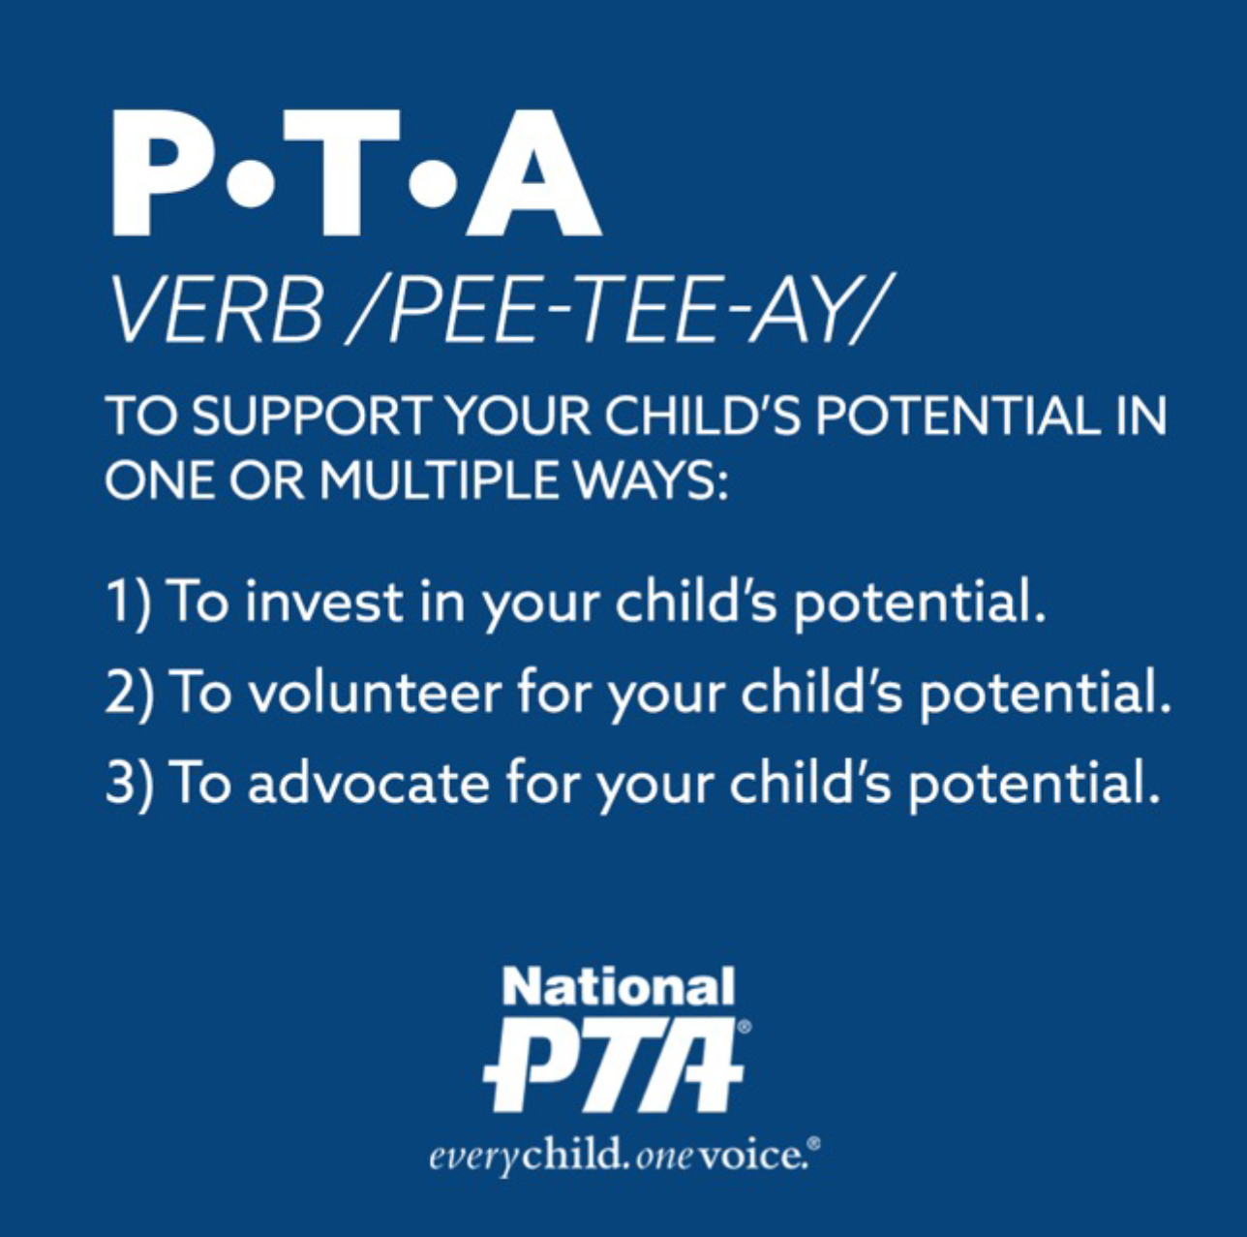
Notes:
Presenter: Amy Fox
Script:
PTA is no longer a noun
It’s a verb – an action plan working to support your child’s success
It’s an invitation to every family in every school because we can do more together than we can do apart
There’s no wrong way to PTA – just as long as you’re doing it for your child
You can give money by joining and donating
You can volunteer time and effort
Or you can help grow our strength and presence at the local, state and national level as advocates for improving your child’s education
The new definition of PTA is: to support your child’s potential in one of multiple ways:
To invest for your child’s potential
To volunteer for your child’s potential
To advocate for your child’s potential
So now how do you put this into action?
How do you communicate this concept of PTA being a verb?
What does the campaign actually look like?
We’ll now show how to PTA For Your Child . . .

Slide 19
messaging
Notes:
Time for Section 4 (slides 19 – 30): 10 minutes
Presenter: Amy Fox
Script:
The messaging will serve as your guide for how to speak about the value of PTA membership and should be used as the foundation for all membership communications

Slide 20
PTA FOR YOUR CHILD
PTA to support your child’s potential. PTA offers all parents and caregivers the opportunity to be engaged in their child’s potential. Being a member of PTA means that you are part of a powerful association and action plan that is focused on programs and initiatives that strengthen your child’s education and the family-school partnership. However you PTA, it’s all an investment in your child. PTA to support your child’s teachers and curriculum. PTA to advocate on the issues impacting your child and affect change at the local, state and national levels. PTA to build a stronger, more diverse and inclusive school community. There's no wrong way to PTA and we invite every family to participate, because we can do more together than apart. How do you PTA?
EDUCATION Support Critical Academic Needs
ADVOCACY Give a Voice to Important Issues
COMMUNITY Build a Stronger, More Inclusive School
PTA to fund essential school resources and curriculum needs, including investments in technology, the arts and science programming.
PTA to be an active voice at the local, state and national levels and to impact decisions affecting your child’s health, safety and quality of education.
PTA to strengthen connections between your family, your child’s classmates and their families, and teachers to build a thriving and inclusive community for everyone.
PTA offers STEM-based learning resources for families through the STEM + Families® program, which includes the STEM at Home activities, Math Nights with Mathnasium and Science Festivals.
PTA provides schools access to experts, resources, trainings and dozens of nationally recognized educational enrichment programs including the Family Reading Experience, in partnership with the Reading is Fundamental.
PTA funds the nation's largest and longest running student arts program, Reflections®, which provides students access to arts, music, literature, dance, drama, and visual arts.
PTA is the oldest and largest child advocacy association in America, comprised of over 22,000 local PTAs and nearly 3.5 million members.
During the past 120 years, PTA’s national advocacy has helped establish universal kindergarten, the National School Lunch Program, the juvenile justice system, and anti-child labor laws.
PTAs are an important advocate at the local and state levels – from the Florida PTA defeating for-profit school management companies to the Washington State PTA securing the passage of an education reform bill that redefined the state’s “Program of Basic Education.”
As a network of over 22,000 schools and nearly 3.5 million families, PTA connects parents and caregivers, students and teachers at the local, state and national level.
PTA supports local needs and strengthens communities across the country – from Georgia where PTA sponsors vision clinics for low-income students and Detroit where a PTA runs after-school programs to California where a PTA created a buddy system between families with limited English proficiency and other bilingual families.
PTA established National Teacher Appreciation Week℠ over 30 years ago to bring together the entire school community to celebrate the outstanding contributions teachers make.
Notes:
Presenter: Amy Fox
Script:
Don’t worry I won’t make you read this, but this is an overview of the message framework that we developed and how it all comes together
Our framework is comprised of a theme, an overarching narrative and three supporting message pillars focused on education, advocacy and community and proof of PTA’s work and impact that support each of the message pillars
This framework is included as part of the materials that accompany the membership campaign toolkit

Slide 21
Notes:
Presenter: Amy Fox
Script:
The membership campaign theme is PTA For Your Child
The theme is a clear, concise phrase that can be used to motivate and recruit new members and engage existing members
We use the theme to inform the messaging and many of the social media assets
We also will provide ideas on how to swap out “PTA” and replace it with relevant verbs that demonstrate PTAs value, action and impact

Slide 22
Overarching
message
YOUR CHILD’S
ALL PARENTS
STRONGER, DIVERSE COMMUNITY
PTA to support your child’s potential.
PTA offers all parents and caregivers the opportunity to be engaged in their child’s potential. Being a member of PTA means that you are part of a powerful association and action plan that is focused on programs and initiatives that strengthen your child’s education and the family-school partnership.
However you PTA, it’s all an investment in your child. PTA to support your child’s teachers and curriculum. PTA to advocate on the issues impacting your child and affect change at the local, state and national levels. PTA to build a stronger, more diverse and inclusive school community.
There’s no wrong way to PTA and we invite every family to participate, because we an do more together than apart. How do you PTA?
HOWEVER YOU PTA
NO WRONG WAY TO PTA
FOCUSED ON
HOW DO YOU PTA?
PROSPECTIVE PTA MEMBERS
Notes:
Presentation Note:
This slide includes a build that will underscore key elements of the messaging contained in the overarching message.
Presenter: Amy Fox
Script:
PTA to support your child
PTA offers all parents and caregivers the opportunity to be engaged in their child’s potential
Being a member of PTA means that you are part of a powerful association and action plan that is focused on programs and initiatives that strengthen your child’s education and the family-school partnership
However you PTA, it’s all an investment in your child
PTA to support your child’s teachers and curriculum
PTA to advocate on the issues impacting your child and affect change at the local, state and national levels
PTA to build a stronger, more diverse and inclusive school community
There’s no wrong way to PTA and we invite every family to participate, because we can do more together than apart
How do you PTA?
Now that I’ve read the message to you, I want to highlight how we’ve pulled through the insights from the research into the messaging
Here we highlight the individual impact to your child
Then focusing on how PTA is for every parent and caregiver, every family
Then we show what PTA is focusing on, what its purpose and mission is
However you PTA reinforces both the notion of PTA as a verb and that there is no right way or wrong way to be a member
We emphasize the desire for and commitment to diversity and inclusion
And then closing out, once again reinforcing that PTA membership can be anything you want it to be and providing a call to action – asking you “How do you PTA?” – bring it back to you as an individual and giving you the license to define how you want to be a member

Slide 23
elevator
speech
PTA membership and dues support your child by funding essential educational and curriculum needs; advocating on behalf of children and educators at the local, state and national levels; and building an inclusive school community for all families.
I invite you to join PTA for your child because increasing our membership, by even one, makes it possible to provide important educational resources, speak up on important issues and create a stronger school community. There is no wrong or right way to be involved — anything you can give, whether it’s time or money, will support your child’s potential.
PROSPECTIVE PTA MEMBERS
Notes:
Presentation Note:
This slide includes a build that will underscore key elements of the messaging contained in the elevator speech.
Presenter: Amy Fox
Script:
The elevator speech is a clear, concise articulation of the value of PTA
This takes the messaging and puts it into simple direct terms
The elevator speech provides a quick and easy answer to “Why should I join PTA?” or “What does PTA do?”
You’ll see some of the same or similar language from the overarching message
Once again, I want to call out a few key elements
Focusing on your child’s impact
What PTA actually does for the school and for children
Articulating the commitment to diversity
Providing an open invitation, a direct ask to join
Demonstrating the impact, the actual work of PTA
Again, driving home – there are no requirements of membership other than paying dues
Closing out here with the personal appeal – by joining PTA, you will have a positive impact on your child

Slide 24
Supporting themes &
Proof points
EDUCATION
How does PTA support students, teachers and curriculum needs?
ADVOCACY
How does PTA advocate on behalf of children at your school at the local, state and national levels?
COMMUNITY
How is PTA a welcoming, inclusive community, committed to strengthening the connection of all families?
PROSPECTIVE PTA MEMBERS
Notes:
Presenter: Amy Fox
Script:
The supporting themes and corresponding messages elaborate on the overarching message and highlight the three areas that define PTA and what it supports: education, advocacy and community
Focusing PTA’s supporting themes and messages around three key areas is critical to reshaping the current perceptions of PTA
For education, we need to think about: how does PTA support students, teachers and curriculum needs?
With advocacy, we need to consider: how does PTA advocate on behalf of children at your school at the local, state and national levels?
And, for community how is PTA a welcoming, inclusive community, committed to strengthening the connection of all families?
Along with each supporting theme and message, we have developed proof points that are the supporting facts for each theme and literally serve as the “proof”
Now we’re going to review each supporting theme in-depth
And, as we go through each supporting theme and corresponding proof points, I want you to begin to think about how you can tailor the proof points to your local PTA

Slide 25
EDUCATION
Support Critical Academic Needs
PTA to fund essential school resources and curriculum needs, including investments in technology, the arts and science programming.
Notes:
Presenter: Amy Fox
Script:
PTA to fund essential school resources and curriculum needs, including investments in technology, the arts and science programming
First and foremost, we want to highlight why kids are in school in the first place – to learn
Therefore, we want to show the direct impact PTA has by supporting critical academic needs
We have also used the PTA as a verb construct for all the pillar messages to drive home this concept and make it more real through our messaging

Slide 26
EDUCATION
Support Critical Academic Needs
PTA offers STEM-based learning resources for families through the STEM + Families® program, which includes the STEM @ Home activities, Math Nights with Mathnasium and Science Festivals.
PTA provides schools access to experts, resources, trainings and dozens of nationally-recognized educational enrichment programs, including the Family Reading Experience in partnership with Reading is Fundamental.
PTA funds the nation’s largest and longest-running student arts program, Reflections, which provides students access to arts, music, literature, dance, drama and visual arts.
Notes:
Presenter: Amy Fox
Script:
Here we provided proof points, the fact-based examples from a National PTA perspective:
PTA offers STEM-based learning resources for families through the STEM + Families® program, which includes the STEM at Home activities, Math Nights with Mathnasium and Science Festivals
PTA provides schools access to experts, resources, trainings and dozens of nationally recognized educational enrichment programs, including the Family Reading Experience in partnership with Reading is Fundamental
PTA funds the nation’s largest and longest running student arts program, Reflections, which provides students access to arts, music, literature, dance, drama, and visual arts
While this is important and effective to share proof points from National PTA, we do strongly encourage you to develop your own proof points
As noted, these should be facts or even data points – not anecdotes or opinions

Slide 27
ADVOCACY
Give a Voice to Important Issues
PTA to be an active voice at the local, state and national levels and to impact decisions affecting your child’s health, safety and quality of education.
Notes:
Presenter: Amy Fox
Script:
PTA to be an active voice at the local, state and national levels and to impact decisions affecting your child’s health, safety and quality of education.
In our research, we found that parents want PTA to serve as an advocate and when they learned more about advocacy efforts, they felt more favorable about joining PTA
Therefore, we want to drive home that PTA and its members give voice to important issues and really emphasize the advocacy work of PTA at all levels

Slide 28
ADVOCACY
Give a Voice to Important Issues
PTA is the oldest and largest volunteer child advocacy association in America, comprised of over 22,000 local PTAs and nearly 3.5 million members.
During the past 120 years, PTA’s national advocacy has helped establish universal Kindergarten, the National School Lunch Program, the juvenile justice system, and anti-child labor laws.
PTAs are important advocates at the local and state levels – from the Florida PTA defeating for-profit school management companies to Washington State PTA securing passage of an education reform bill that redefined the state’s “Program of Basic Education.”
Notes:
Presenter: Amy Fox
Script:
The proof of this from the national level includes:
PTA is the oldest and largest child advocacy association in America, comprised of over 22,000 local PTAs and nearly 3.5 million members
During the past 120 years, PTA’s national advocacy has helped establish universal Kindergarten, the National School Lunch Program, the juvenile justice system, and anti-child labor laws
PTA’s are important advocates at the local and state levels – from the Florida PTA defeating for-profit school management companies to Washington State PTA securing passage of an education reform bill that redefined the state’s “Program of Basic Education
Once again, it is really important for you think about how to localize these proof points
If you don’t have ones at your local PTA level, please look to your regional or county PTA, and state PTA

Slide 29
COMMUNITY
Build a Stronger, More Inclusive School
PTA to strengthen connections between your family, your child’s classmates, their families, and teachers to build a thriving and inclusive community for everyone.
Notes:
Presenter: Amy Fox
Script:
I want to stop for a moment and really talk about community
As we know from our research and our own experience, the notion of a social club and/or exclusive clique is often associated with PTA
What we didn’t want to do was completely dismiss or ignore the social aspect of PTA, because we know that it is an important part of the organization, and our research also supports that notion
So what we did was deliberately reframe the concept of social club to community, because that is what a lot of the important social activities do – build community among families and with the teachers and administrators
Community also allows us to tackle the important desire and necessity for all PTAs to demonstrate a real commitment to diversity and inclusion, and be an organization that welcomes all families
You’ll also see changing the notion of social club to community come to life in a fun, playful way in our social media graphics
So for community we want to clearly state that it means building a stronger, more inclusive school
PTA to strengthen connections between your family, your child’s classmates, their families, and teachers to build a thriving and inclusive community for everyone

Slide 30
COMMUNITY
Build a Stronger, More Inclusive School
As a network of over 22,000 schools and nearly 3.5 million families, PTA connects parents and caregivers, students and teachers at the local, state and national level.
PTA supports local needs and strengthens communities across the country – from Georgia where PTA sponsors vision clinics for low-income students to Detroit where PTA runs afterschool programs to California where PTA created a buddy system between families with limited English proficiency and other bilingual families.
PTA established National Teacher Appreciation Week℠ over 30 years ago to bring together the entire school community to celebrate the outstanding contributions teachers make.
Notes:
Time:
Presenter: Amy Fox
Script:
To demonstrate this from a national level, our proof points include:
As a network of over 22,000 schools and nearly 3.5 million families, PTA connects parents and caregivers, students and teachers at the local, state and national level
PTA supports local needs and strengthens communities across the country – from Georgia where PTA sponsors vision clinics for low-income students and Detroit where PTA runs afterschool programs to California where PTA created a buddy system between families with limited English proficiency and other bilingual families
PTA established National Teacher Appreciation Week℠ over 30 years ago to bring together the entire school community to celebrate the outstanding contributions teachers make.
From the local level, this is where you can talk about festivals and carnivals, book fairs, movie nights, spirit week, teacher appreciation activities, and other community building activities

Slide 31
Collateral materials & templates
Notes:
Time for Section 5 (slides 31 – 35): 5 minutes
Presenter: LaWanda Toney
Script:
How do we bring this all to life and drive interest and engagement?
The messaging will serve as your guide for how to speak about the value of PTA membership, but the visual assets – the collateral materials and templates – will be how you tell that story visually and dynamically.

Slide 32

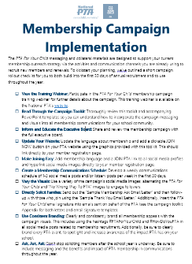


Notes:
Presenter: LaWanda Toney
Script:
We have created an entire suite of materials for you use
At the center here and core to the campaign is the campaign toolkit – this will include all information you will need about the campaign messaging and visuals and includes all the information we’re reviewing here today
We know it is critical to embrace digital communications and that many of you primarily rely on social media to communicate to parents and families in your school, so we created a campaign video and comprehensive suite of social media materials, as well as written materials to assist you in your membership campaign outreach
Finally, as you can see on the right – we’ve even included tips on how to get started that will review in greater detail in a few moments

Slide 33







SOCIAL MEDIA
VISUALS
OVERLOOKED AUDIENCES
Notes:
Presentation Note:
The larger side-by-side graphic will appear on a click
Click to make it appear when noted in the script below
Presenter: LaWanda Toney
Script:
The PTA For Your Child social media visual images, or social media cards, are designed for your PTA to use on Facebook, Twitter, or Instagram
We have designed a complete suite of images that provide you with many options, including an animated GIF and customizable images to highlight your PTA’s accomplishments and priorities for your school
Many of the social cards are easily customizable so that you can add in pictures from your school and specific proof points that articulate the impact of the programs locally
We also have materials that don’t require customization, if you prefer to use those instead
It is important to note, that we provide detailed directions for how to customize the graphics so that any one of any technical ability is able to add in images and/or text
As mentioned earlier, we want to use this campaign to dispel many of the misperceptions associated with PTA
One way we are doing that in a visual and fun way is through what we’re calling our side-by-side graphics [CLICKE TO REVEAL LARGER SIDE-BY-SIDE GRAPHIC]
As you can see here, on the left is a misperception that PTA is only about fun activities, but left side shows that it’s about fun AND important fundraising activities that support the school’s curriculum, provides school supplies and other key educational programs
As noted earlier, we don’t necessarily want to hide from some of these misperceptions – we want to use them to show what PTA is really about

Slide 34

Email & website
banners
REACHED AUDIENCES
OVERLOOKED AUDIENCES
Notes:
Presenter: LaWanda Toney
Script:
The PTA For Your Child email and website banner images are designed for use in school-wide emails related to PTA membership activities and initiatives
Additionally, these images can be used on your PTA website or your school’s homepage, if it has a link to the PTA site
We also suggest hyperlinking the banner images directly to your membership registration page
We also suggest placing one of the “Join Now” button graphics on your PTA website
The graphic should be hyperlinked so that when a user clicks on the link it will take them directly to the page to sign up for membership

Slide 35

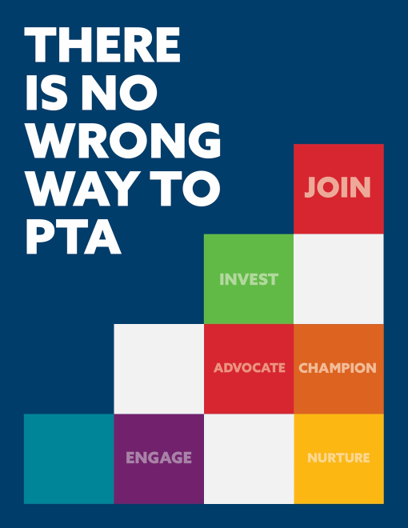

Posters &
flyers
REACHED AUDIENCES
OVERLOOKED AUDIENCES
Notes:
Presenter: LaWanda Toney
Script:
The PTA For Your Child printable posters and flyers can be posted throughout the school or handed out to families at PTA meetings or any school-wide event hosted by the PTA.
These printable posters and flyers can be customized to include your own PTA-related images and we have included black and white and color options

Slide 36
implementation
Notes:
Time for Section 6 (slides 36 – 38): 5 minutes
Presenter: LaWanda Toney
Script:
The PTA For Your Child messaging and collateral materials are designed to integrate seamlessly into your current membership outreach strategy via the activities and communications channels you are already using to recruit new members and renewals
To kickstart your planning, we’ve outlined a short campaign rollout checklist for you to build into the first 30 days of annual recruitment and to use throughout the year

Slide 37
Implementation
Checklist
Participate in the Webinar
Read the Toolkit
Inform your Executive Board
Update Your Website
Make Joining Easy
Create a Schedule
Vary the Visuals
Directly Solicit Families
Use Consistent Branding
Ask, Ask, Ask!
OVERLOOKED AUDIENCES
Notes:
Time:
Presentation Note:
The checklist is an animated build that advances manually by clicking to reveal the next item on the list
Presenter: LaWanda Toney
Script:
The good news, you’ve already completed the first step by viewing this Training Webinar
Next, we ask that you read through the toolkit and accompanying materials – this will allow you to thoroughly understand how to incorporate the campaign messaging and visuals into all membership communications
Review the campaign approach and materials with your Executive Board to inform them of the importance and necessity of this campaign
Update your website and begin using the messaging and visuals in all of your PTA communications
Make joining easy by adding the membership language and a Join PTA link on all social media platforms and hyperlink images to the membership registration page
Create a communications schedule to develop a cadence of information being shared via and on social media – it’s important to remember to ask people to join often and that message repetition leads to better understanding
Use the full suite of visuals, alternating images and messaging to engage and inform your followers
Directly ask families to join use the membership solicitation email provided as part of the toolkit
Clearly and consistently brand all membership appeals with the visuals developed for this campaign, this includes using the hashtags “PTAForYourChild” and “HowDoYouPTA?” – also clearly brand all PTA events, this will further increase awareness of PTA and its impact in your school
Finally, Ask, Ask, Ask – don’t stop asking people to join after the first month or so of school has passed
Be sure to include membership messaging including the benefits and impact of PTA membership in all communications throughout the year
And, if you have any questions about implementation – National PTA is here as a resource, so please don’t hesitate to reach out

Slide 38

HOW
DO
YOU
PTA?
Notes:
Presentation Note:
GIF animation will begin automatically
Once the animation ends, the GIF will automatically disappear and “How Do You PTA?” will appear
Presenter will begin closing remarks once “How Do You PTA?” appears on the screen
Presenter: Leslie Boggs
Script:
I hope you are as excited and inspired by the membership campaign as I am
Now it’s time think about “How Do You PTA?” and introduce and implement our new membership campaign in your state, regional and local PTAs
We cannot thank you enough for the work you do on behalf of PTA
You are making a difference in your child’s education and the education of all students at your school
It is our sincere hope and believe that this new membership campaign will increase membership and allow you to build on the important work you’re already doing
Thank you so much for your time

